Slide 1
Network Overview Discovery and Exploration for Excel (NodeXl)
Hands On Exercise
Presented by: Samer Al-khateeb
Class: Social Media Mining and Analytics (IFSC 3360)
Date: November 6, 2014

Slide 2
Out Line
What Can We Do With NodeXl?
NodeXl Features.
How to Install and Run NodeXl? Windows Only.
How to Collect Data From Social Media?
Visual Properties With NodeXl.
How to Install The Social Network Importer For NodeXL:
How To Create a Twitter Application?

Slide 3
1. What Can We Do With NodeXl?
Collect Data From:
Twitter
Facebook: require extra files …..
YouTube
Flicker
Visualize The Data with Different Layouts.
Import Data Of Different Format
Analyze The Data i.e.
Grouping.
Clustering,… etc.
Export the Data in Different Format to Be Used with Another Software.
Notes:
The spreadsheet naturally allow the user to specify and interact with the contents and the interconnections of the cells.
ASP: Display images in a cell
Levoy: shows how a spreadsheet can be used to examine an image processing pipeline,
Hasler shows how many image processing tasks can be efficiently organized in a spreadsheet system.
These two systems illustrate some of the capabilities made possible by extending the spreadsheet paradigm to other domains.
Visualization Systems are: modular, easy-to-use, extensible tools
Application Areas from: hypertext information to geology, molecular biology, file system structure, and animal behavior patterns.

Slide 4
2. NodeXl Features
Flexible Import and Export Import and export graphs in GraphML, Pajek, UCINet, and matrix formats.
Direct Connections to Social Networks Import social networks directly from Twitter, YouTube, Flickr and email, or use one of several available plug-ins to get networks from Facebook, Exchange, Wikis and WWW hyperlinks.
Zoom and Scale Zoom into areas of interest, and scale the graph's vertices to reduce clutter.
Flexible Layout Use one of several "force-directed" algorithms to lay out the graph, or drag vertices around with the mouse. Have NodeXL move all of the graph's smaller connected components to the bottom of the graph to focus on what's important.
Easily Adjusted Appearance Set the color, shape, size, label, and opacity of individual vertices by filling in worksheet cells, or let NodeXL do it for you based on vertex attributes such as degree, betweenness centrality or PageRank.
Dynamic Filtering Instantly hide vertices and edges using a set of sliders—hide all vertices with degree less than five, for example.
Powerful Vertex Grouping Group the graph's vertices by common attributes, or have NodeXL analyze their connectedness and automatically group them into clusters. Make groups distinguishable using shapes and color, collapse them with a few clicks, or put each group in its own box within the graph. "Bundle" intergroup edges to make them more manageable.
Graph Metric Calculations Easily calculate degree, betweenness centrality, closeness centrality, eigenvector centrality, PageRank, clustering coefficient, graph density and more.
Task Automation Perform a set of repeated tasks with a single click.

Slide 5
3. How to Install and Run NodeXl?
Are you upgrading from an older version of the NodeXL Excel Template? If so, you must uninstall the older version before you install NodeXL Excel Template 2014.
Download the NodeXLExcelTemplate2014Setup.exe file from this page (http://nodexl.codeplex.com/releases/view/117659), then run it.
If you are asked to accept the "Microsoft Visual Studio 2010 Tools for Office Runtime (x86 and x64)", click the Accept button.
When you are asked "Are you sure you want to install this customization?", click the "Install" button.
In the Windows Start menu or Start screen, search for "NodeXL", then click "NodeXL Excel Template" in the search results.
Notes:
This paper is about presenting "a novel visualization spreadsheet framework" that is different than the "traditional spreadsheets". Here the cells can hold:
an entire complex data set,
selection criteria,
viewing specifications,
and other information needed for a full-fledged information visualization.
Also the inter-cell operations are far more:
complex, stretching beyond simple arithmetic and string operations to encompass a range of domain-specific operators.
I like it because I like spreadsheet and I chose it to see how spreadsheets can be used in information visualizations
Spreadsheets are highly successful tools for interacting with numerical data, such as:
1 applying algebraic operations,
2 manipulating rows or columns,
3 and exploring “what–if” scenarios.
A. spreadsheets are of direct value to end-users, because the direct manipulation interface makes it easy:
1. to view,
2. navigate,
3. and interact with the data.
B. On the other hand, spreadsheets provide a flexible and easy-to- learn programming environment.
they chose this approach because of the informtion visualizations problems:
1. much of the user interaction is the application of operations, such as comparison, filtering, and animation.
2. the exploration of different methods for representing data.
Solution: spreadsheets enables information visualizers to solve both problems in a single environment.
1. it facilitates the easy application of oper- ations, such as direct manipulations of the visualizations, and the entry of formulas that specify relationships between cells.
2. it also supports the exploration of different visual representation techniques by emphasizing the operands rather than the operators

Slide 6
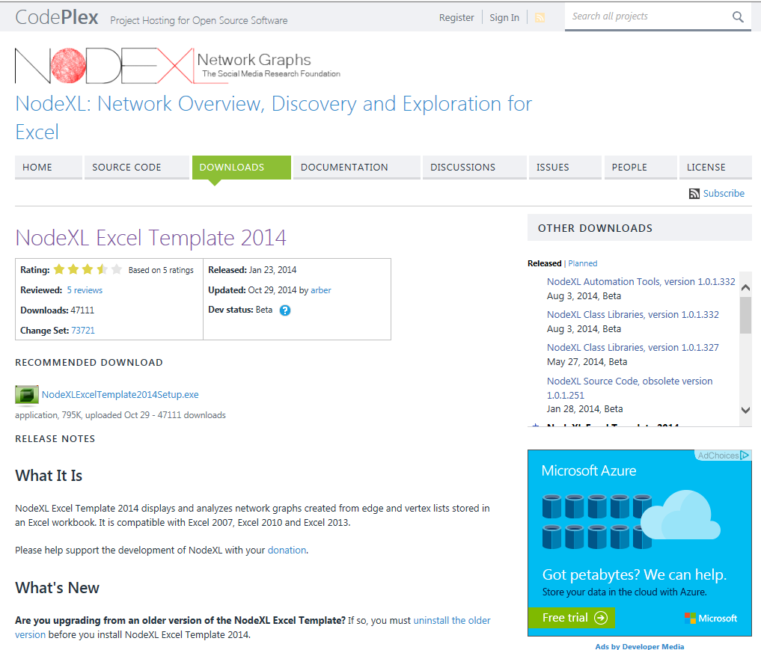
How to Install and Run NodeXl Cont…

Slide 7
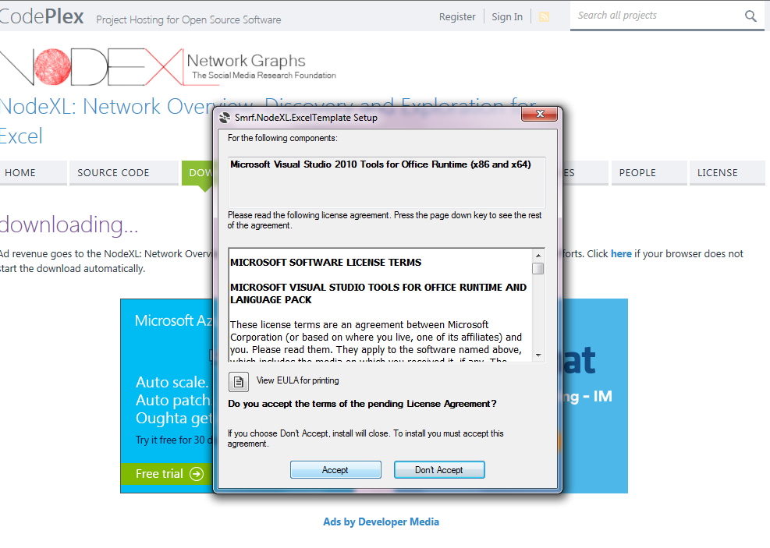
How to Install and Run NodeXl Cont…

Slide 8
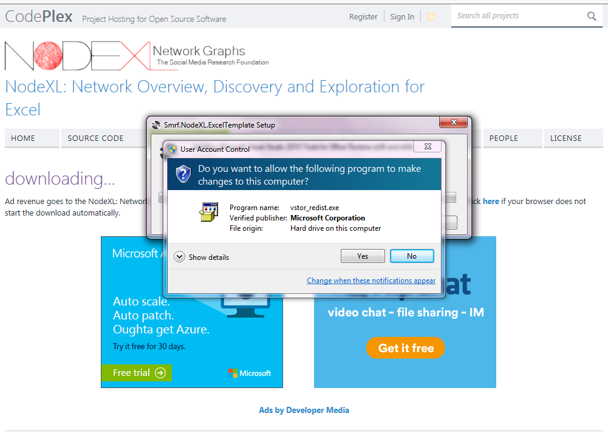
How to Install and Run NodeXl Cont…

Slide 9
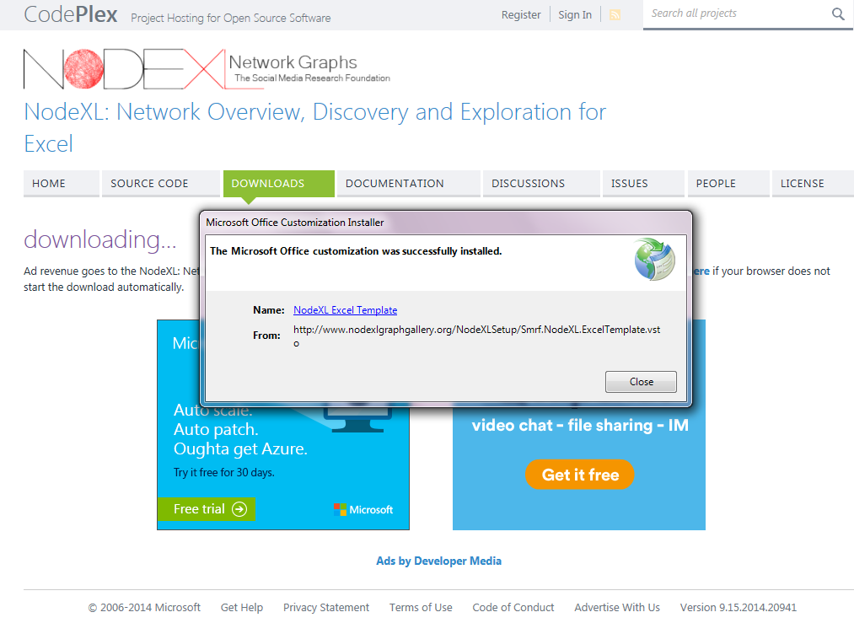
How to Install and Run NodeXl Cont…

Slide 10
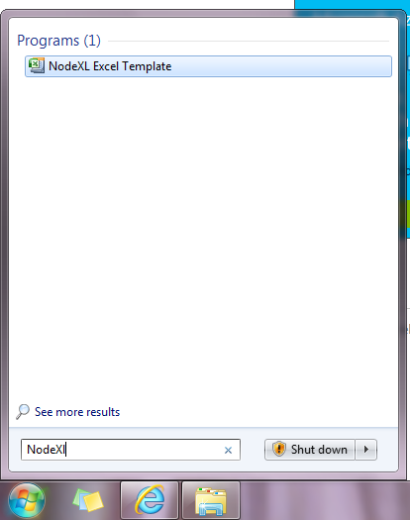
How to Install and Run NodeXl Cont…

Slide 11
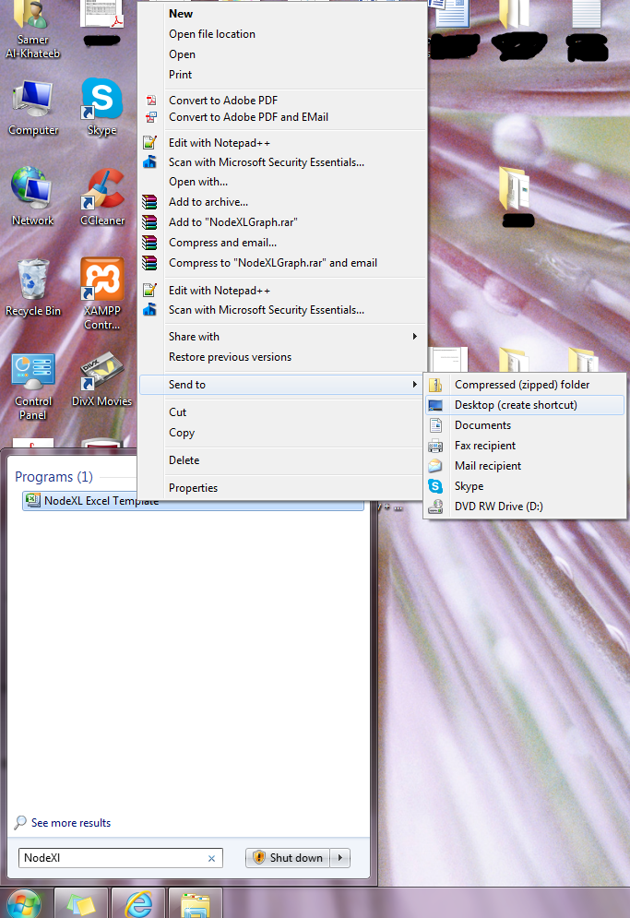
How to Install and Run NodeXl Cont…

Slide 12
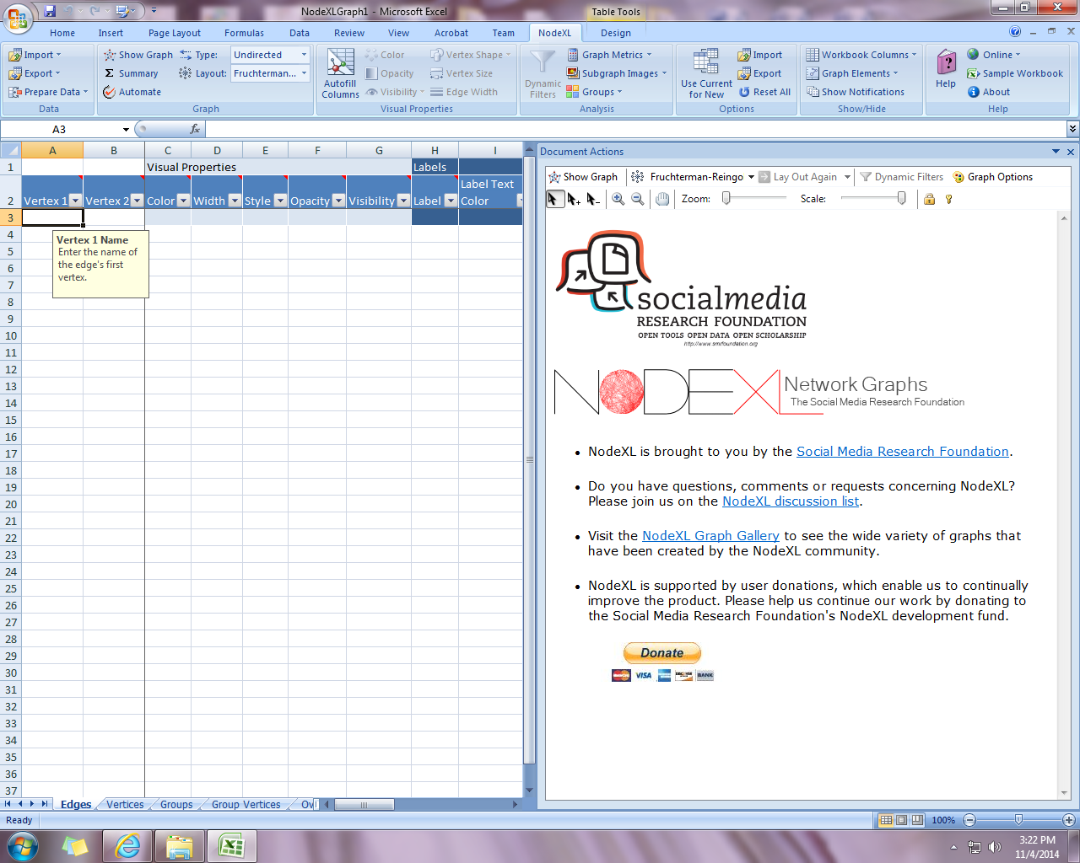
How to Install and Run NodeXl Cont…

Slide 13
How to Install and Run NodeXl Cont…
You Need a Twitter Account
Go To: https://twitter.com and create an account.

Slide 14
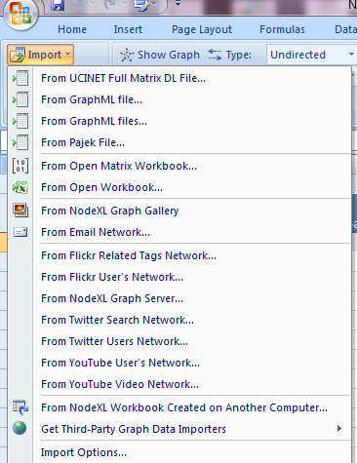
How to Install and Run NodeXl Cont…

Slide 15
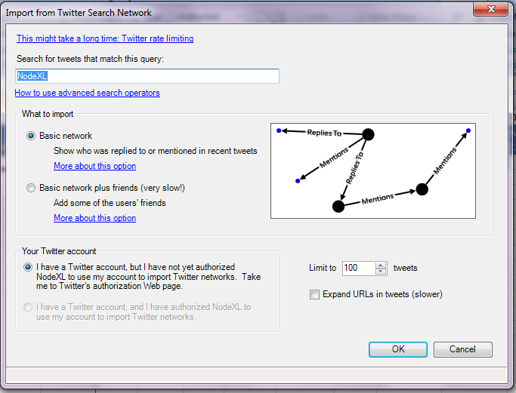
How to Install and Run NodeXl Cont…

Slide 16
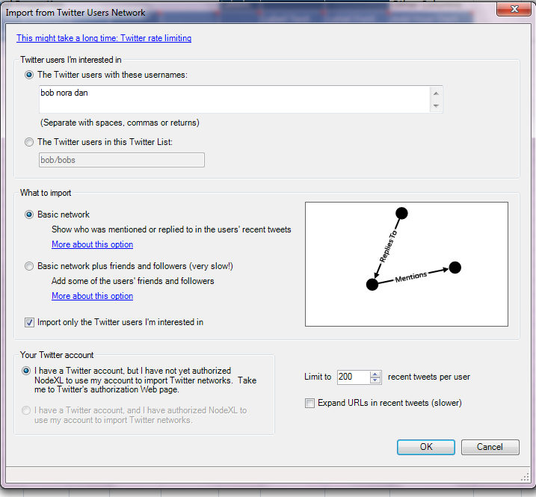
How to Install and Run NodeXl Cont…

Slide 17
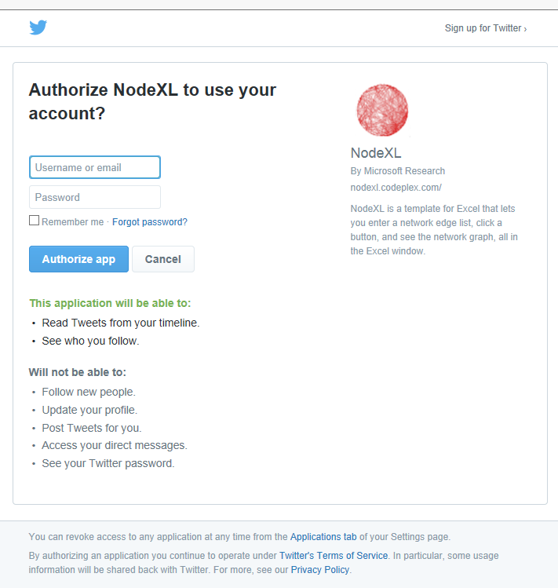
How to Install and Run NodeXl Cont…

Slide 18
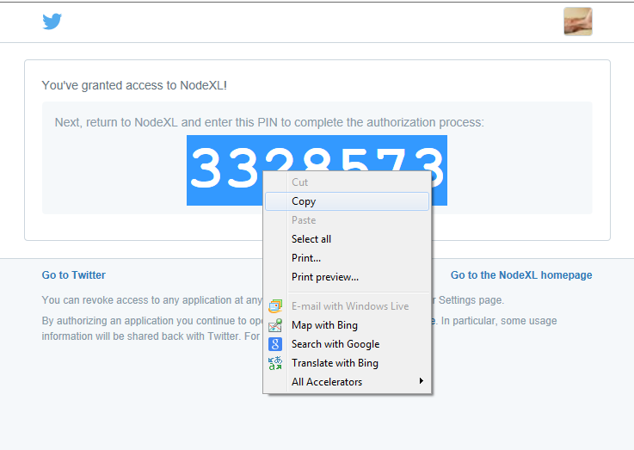
How to Install and Run NodeXl Cont…

Slide 19
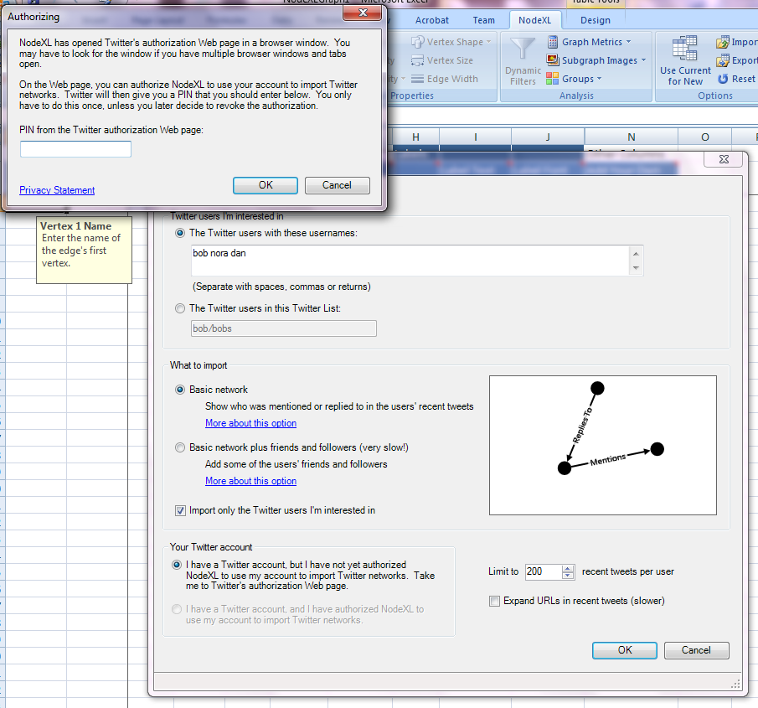
How to Install and Run NodeXl Cont…

Slide 20
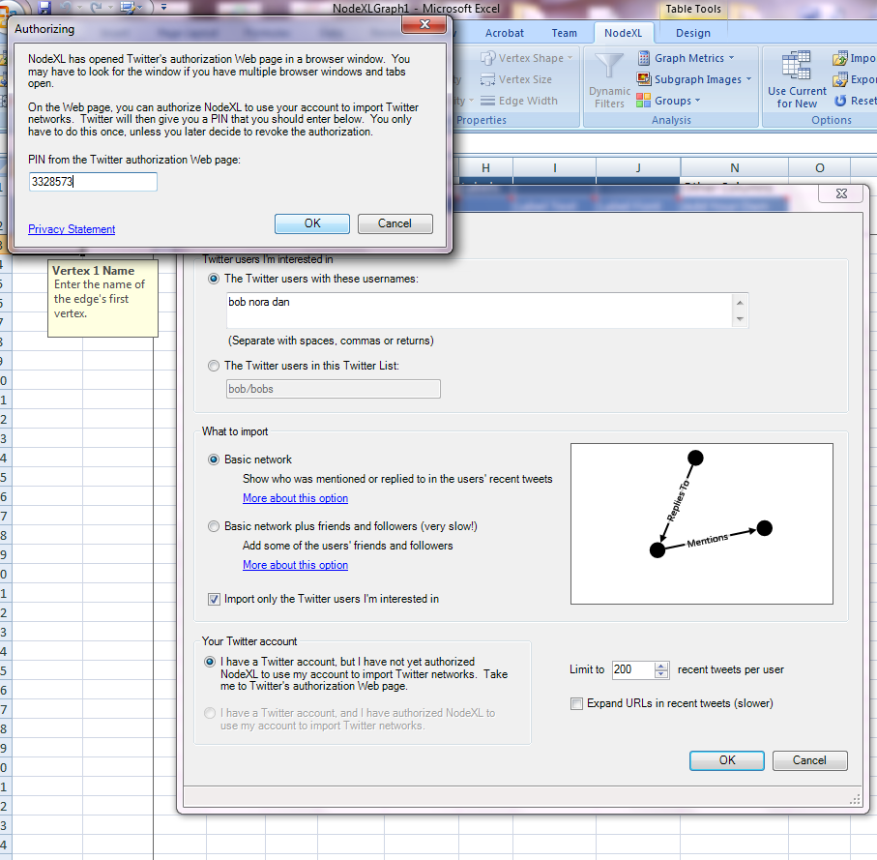
How to Install and Run NodeXl Cont…

Slide 21
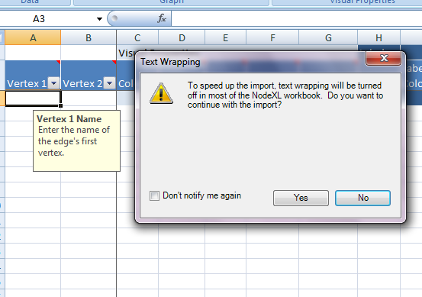
How to Install and Run NodeXl Cont…

Slide 22
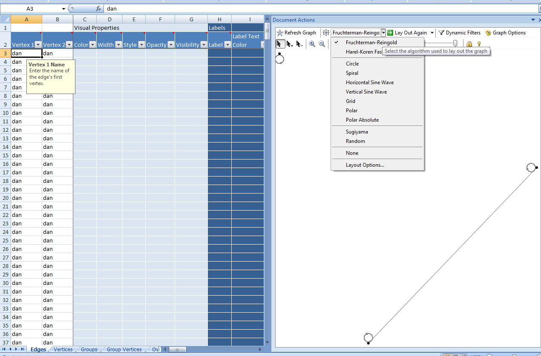
How to Install and Run NodeXl Cont…

Slide 23
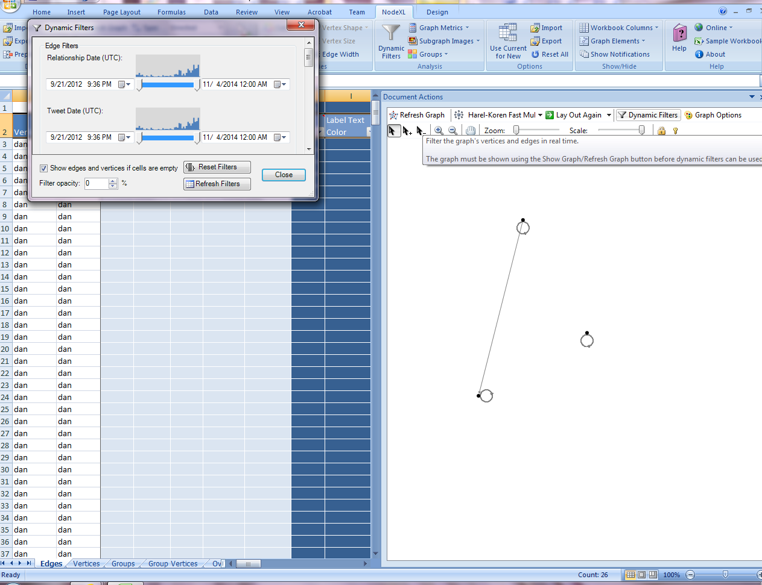
How to Install and Run NodeXl Cont…

Slide 24
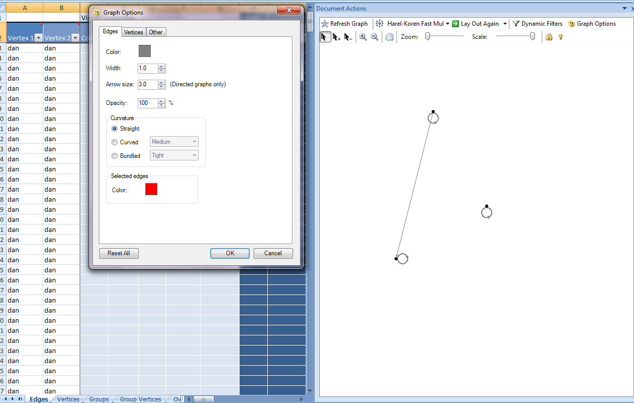
How to Install and Run NodeXl Cont…

Slide 25
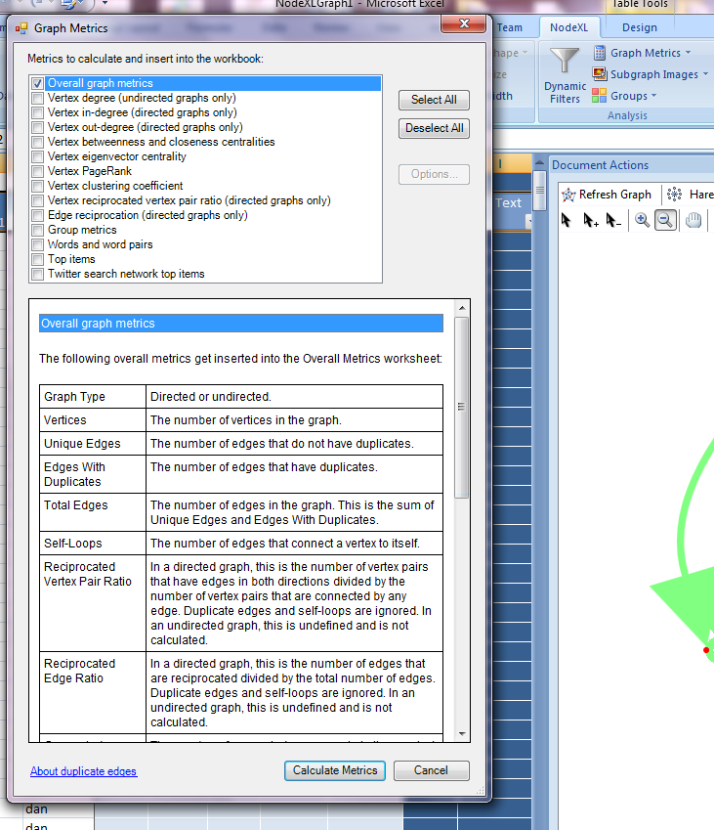
How to Install and Run NodeXl Cont…

Slide 26
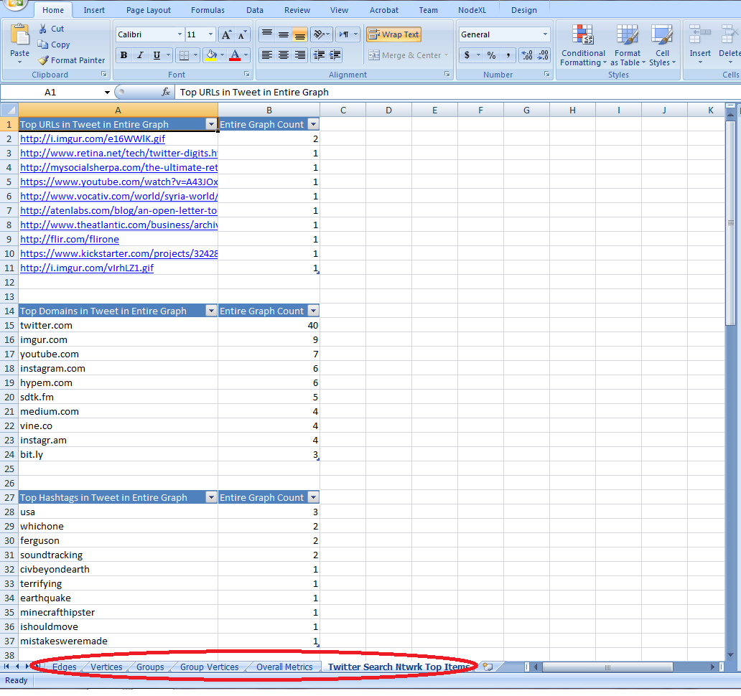
How to Install and Run NodeXl Cont…

Slide 27
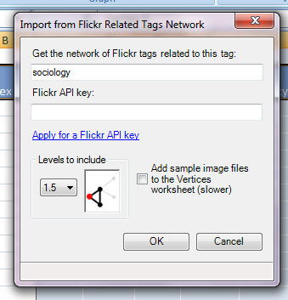
4. How to Collect Data from Social Media?

Slide 28
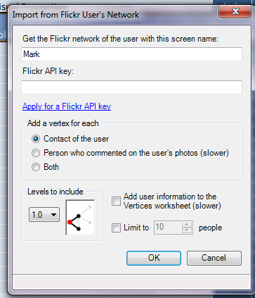
How to Collect Data from Social Media Cont…

Slide 29
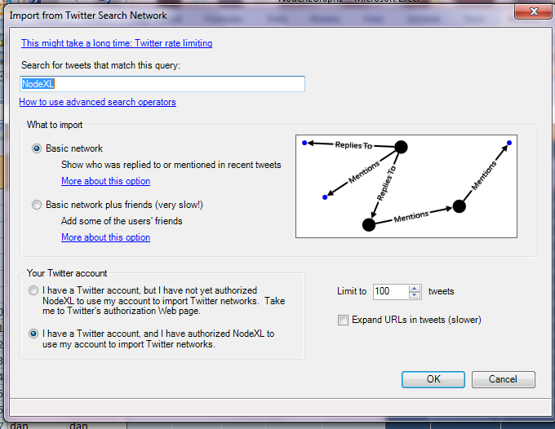
How to Collect Data from Social Media Cont…

Slide 30
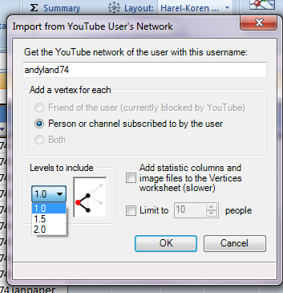
How to Collect Data from Social Media Cont…

Slide 31
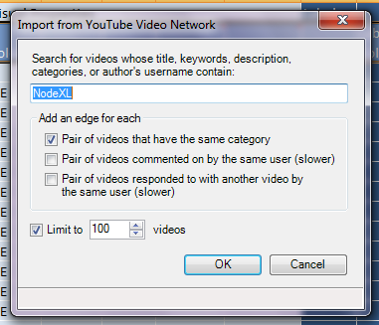
How to Collect Data from Social Media Cont…

Slide 32
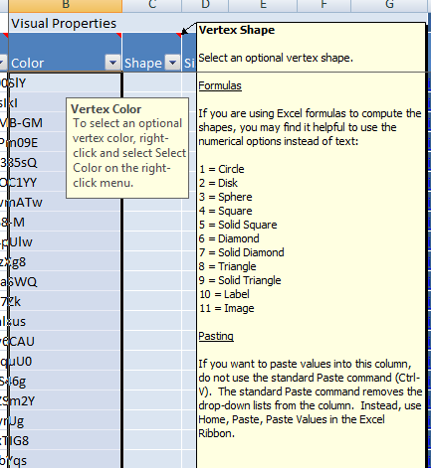
5. Visual Properties with NodeXl:

Slide 33
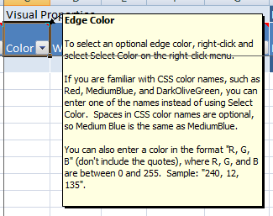
Visual Properties with NodeXl Cont…

Slide 34
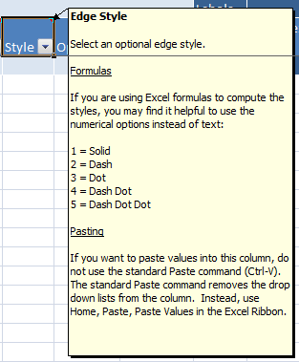
Visual Properties with NodeXl Cont…

Slide 35
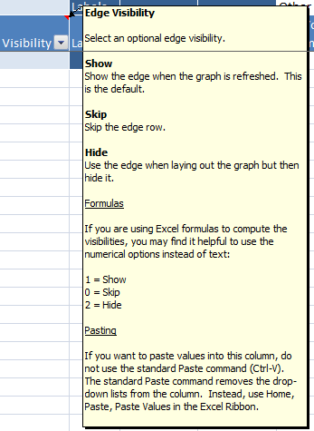
Visual Properties with NodeXl Cont…

Slide 36
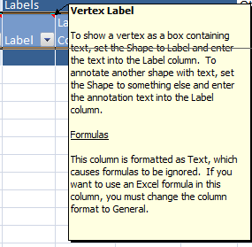
Visual Properties with NodeXl Cont…

Slide 37
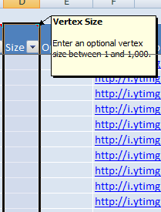
Visual Properties with NodeXl Cont…

Slide 38
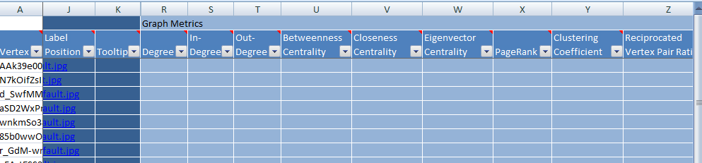
Visual Properties with NodeXl Cont…

Slide 39
6. How to install the Social Network Importer for NodeXL?
Close NodeXL
Download the zip file from http://socialnetimporter.codeplex.com/
Unzip the file: you will find two items:
FacebookAPI.DLL
SocialNetImporter.DLL
Copy these files to the NodeXL Plug-ins Directory specified in the "Import Options..." (Using third-party graph data importers in NodeXL Excel Template 2014)
Restart NodeXL: you should see the Facebook Import option in the NodeXL>Data>Import menu.

Slide 40
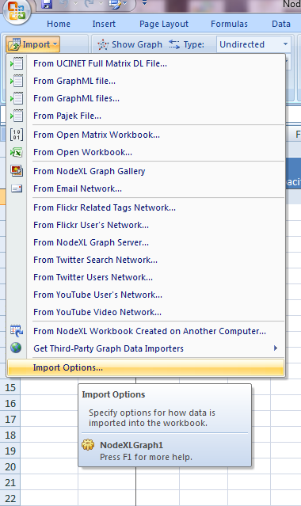
How to install the Social Network Importer for NodeXL Cont…

Slide 41
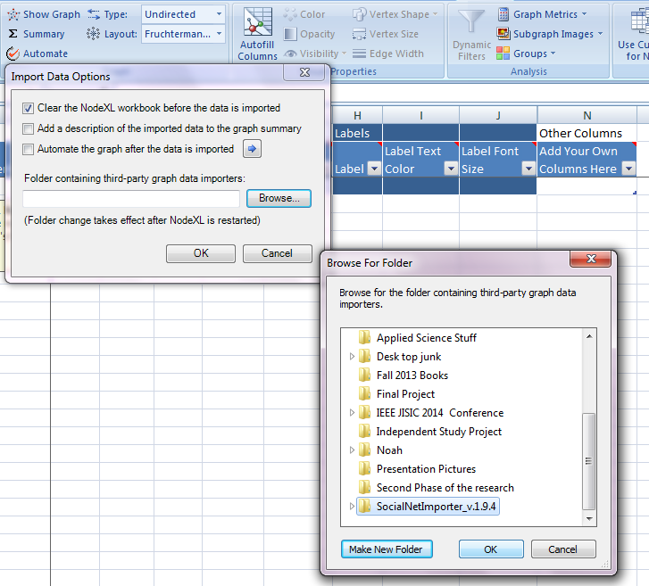
How to install the Social Network Importer for NodeXL Cont…

Slide 42
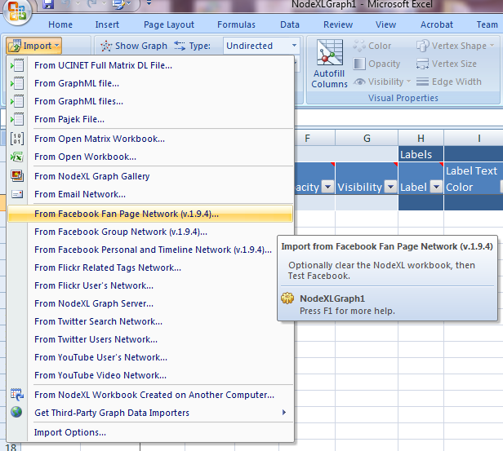
How to install the Social Network Importer for NodeXL Cont…

Slide 43
7. How To Create Twitter Application
Create an app to get the App Key
Go to : https://dev.twitter.com
Then Developers → Documentations →Manage My Apps
OR Go Directly to : https://apps.twitter.com
Sign In with you twitter account
Click on Create New App Button
Fill the information of the App as shown in the next slides.

Slide 44
How To Create Twitter Application Cont…

Slide 45
How To Create Twitter Application Cont…

Slide 46
How To Create Twitter Application Cont…
Save This!

Slide 47
How To Create Twitter Application Cont…

Slide 48
How To Create Twitter Application Cont…

Slide 49
How To Create Twitter Application Cont…

Slide 50
Thanks
Questions?

